Slide 1
Meet the Teacher
Pine Class –Year 1
Mrs Whitelock (M,T,W)
and
Mrs Jinkerson (Th, F)
with
Gazel (M,T,W,Th)
and
Louise (F)
LSA’s Matthew, Jeannie, Louise W, Sarah, Milly, Liz G, Lisa

Slide 2
General Information
Morning Snack – Healthy snack sent in from home please.
Afternoon snack provided by school.
Water bottles
Clothes labelling – please name everything
PE sessions x 2 – Wednesday and Thursday. Please keep PE kit in school all week.
Forest Learning - Alternate Thursday Mornings

Slide 3
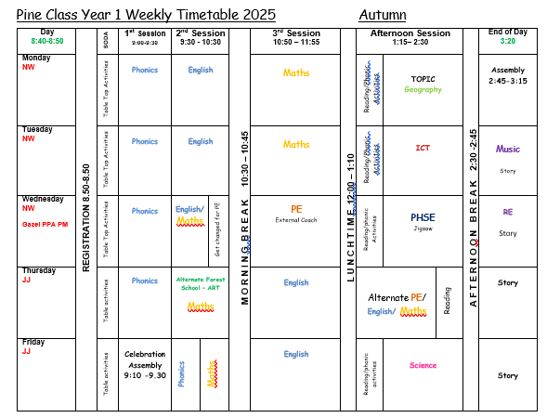
Timetable and routines
Morning routine:
  put any large bags on the outside pegs.
  PE bags, hats and coats are put on the inside pegs.
  Their book bags go in their named drawers.
  Books in the coloured trays
  Morning activity at the tables

Slide 4

Messages
Class email Pine@bentfield.essex.sch.uk
At drop off for quick messages or collection for a longer chat.
Please ring the school or email if your child is going to be absent.
Please inform us, by email, of any collection arrangements.

Slide 5
Independence and learning in year 1
Children being responsible giving their books in each day – two trays, finished or not. We will change them throughout the week.
Putting their own things away in the morning.
Our class reward system is collecting bees. Pupils will be allowed to stamp the class Bee chart and collect a sticker when they’re spotted upholding our class values. When we’ve collected 30 as a class we will have a class reward!

Slide 6
Our topics
Autumn- Our World
Spring – No Place Like Home Summer – Amazing Animals, Toys

Slide 7
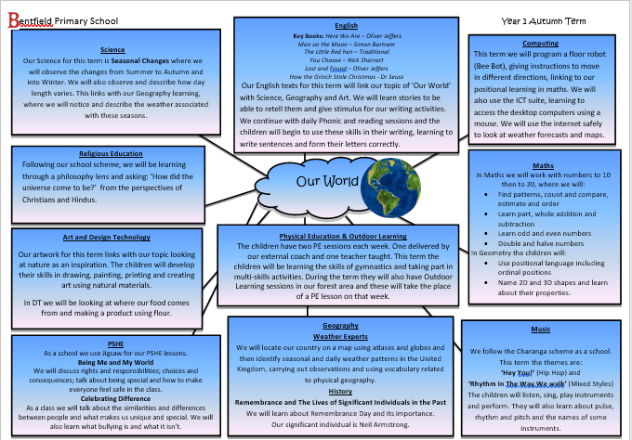
Our World

Slide 8
Reading
Children will be given two reading books that match their ability.
We aim for children to read at least twice a week in school.
Children will bring their reading books home in their book bag.
Please try and read with your child as often as possible. Ideally every night.
Please let us know that your child has read at home by leaving a small comment and which page they are on next or write finished book.
Books will be changed when finished throughout the week.
Bug club logins allow you to read online books.

Slide 9
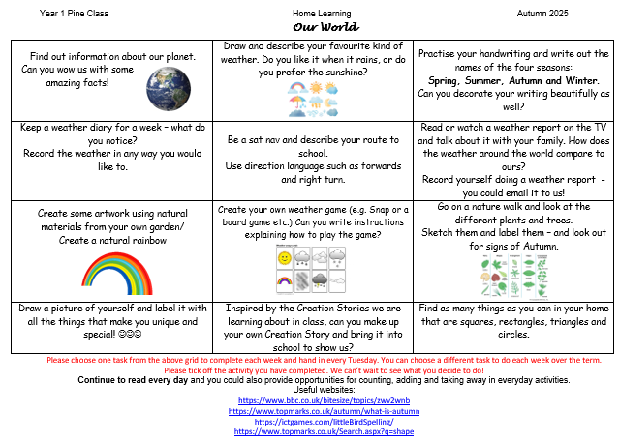
Homework
Home on Thursday
Back on Tuesday

Slide 10
Forest Learning – We will email you when it is a Forest Learning week
Children need
  long sleeved tops
  long trousers,
  waterproof trousers,
  welly boots and a warm, waterproof coat (that you don’t mind getting dirty!).

Slide 11
Any questions?

